Slide 1
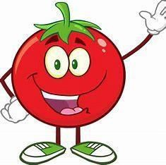


Slide 2


THE HYPE OF TOMATOES PRICE

Slide 3
Presented by:
SHARMILA.S (927621BEC197)
GUIDED BY:
DR.R.KalaIARasan Ap/ece

Slide 4
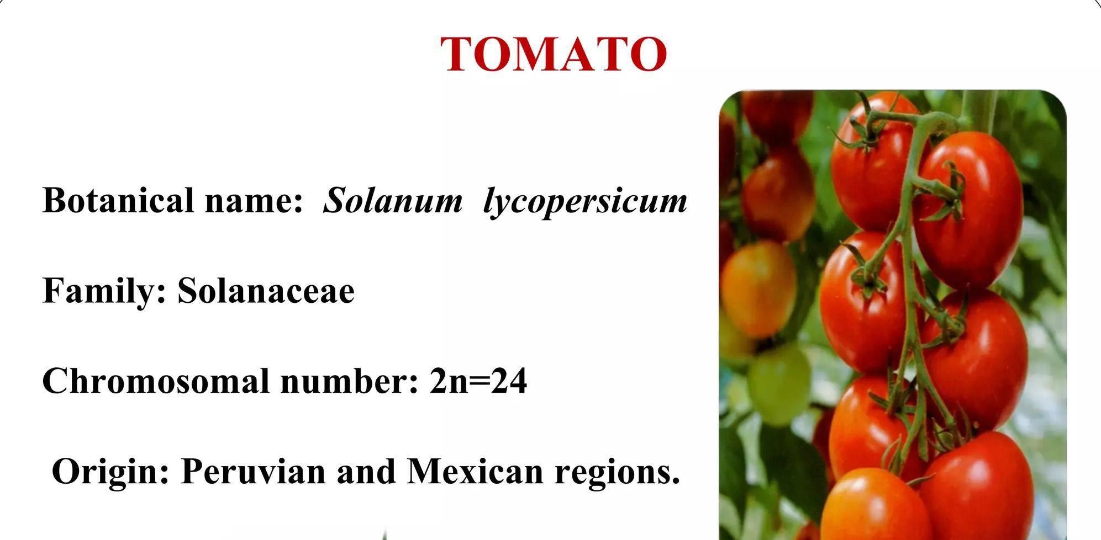

Slide 5
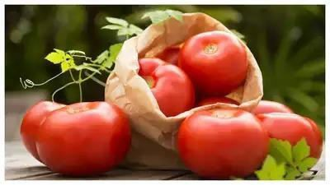
INTRODUCTION
 When it comes to cooking essentials, potatoes, tomatoes, and onions are considered important
 when any of these face skyrocketing price hikes
 It surely disturbs the monthly budget of every Indian household.
 In the past, onions made us cry, and this time tomatoes have made it sour for us.
 As per reports, from Rs 15 per kg in the first week of May, today, it has reached to staggering Rs 110-140 per kg in different parts of the country.

Slide 6
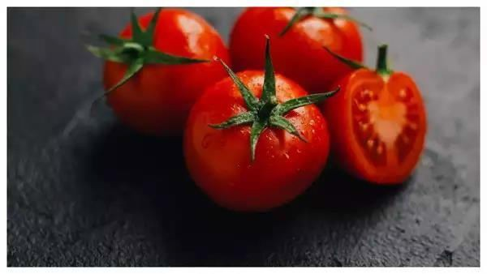
WHY ARE TOMATOES SO EXPENSIVE
 As per reports, the main reason behind the current high prices can be traced back to the sudden rise in temperature in March and April
 That saw pest attacks on the production that led many growers to abandon their crops.

Slide 7
The production of tomatoes in India
 India grows two crops of tomato.
 First is the rabi crop
 Rabi crop is grown in Junnar Taluka of Maharashtra and in parts of Karnataka and Andhra Pradesh
 which comes to the market between March and August.
Continued..
 Second is the Kharif crop
 It is grown in UP and Nashik
 It comes during the rest of the year

Slide 8
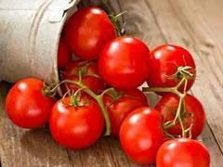
 These places are the major suppliers of tomatoes in the country
What went wrong this year?
 The first batch of small saplings is transplanted in raised beds, during January-March, which results in the first batch of supplies during AprilJune.
 And if reports are to be believed the Rabi crop fetches better returns to the farmers.
 However, this year, farmers suffered a shock in March-April due to sudden heat

Slide 9
Continued..
 The leaf curl virus and cucumber virus spoiled the saplings and most crops coming to the market were of inferior quality.
 Hence, keeping the uncertainty of price and supplies in view, they sold it all which later resulted in a scarcity of fresh produce.
Any chances for prices to come down?
 Well, as per experts, prices will come down only when the Kharif tomato will be pushed into the market
 Of which the transplantation has begun after the arrival of the monsoon.

Slide 10
 Hence, it will be only post-mid-August that the fresh produce will be pushed into the market
 It will bring down the retail prices.

Slide 11
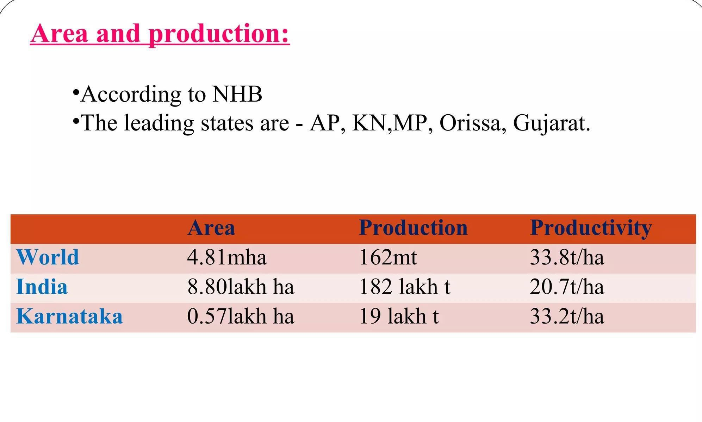

Slide 12
Nutrition
One whole tomato provides the following
 Calories: 22.5
 Carbohydrates: 4.86g
 Fat: 0.25g
 Protein: 1.1g
 Vitamin C: 17.1mg, 19% of the daily value Potassium: 296mg, 6% of the daily value
 Vitamin K: 9.88mcg, 8% of the daily value
 Folate: 18.8mcg, 4.7% of the daily value
TOMATO DISEASES

Slide 13
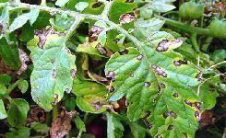
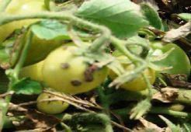
Septoria leaf spot
Bacterial stem and fruit canker
Mosaic

Slide 14
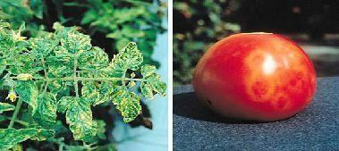
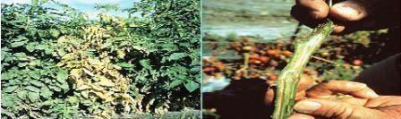
Fusarium wilt

Slide 15
USES OF TOMATO
 Eating raw in salads or cooked in various dishes and sauces
 Providing vitamin C , lycopene and other antioxidants that may prevent cancer and other diseases
 Supporting heart health, blood pressure, eye health, skin health
 It is famous for being used in pizzas and sandwiches

